Slide 1
Icarus Verilog

Slide 2
Install Icarus Verilog
Icarus Verilog for Windows
http://bleyer.org/icarus/
Icarus Verilog Installation on Mac OS X
http://e-lab.github.io/html/wiki-icarus-verilog-installation-on-mac.html
Out of date; need to search

Slide 3
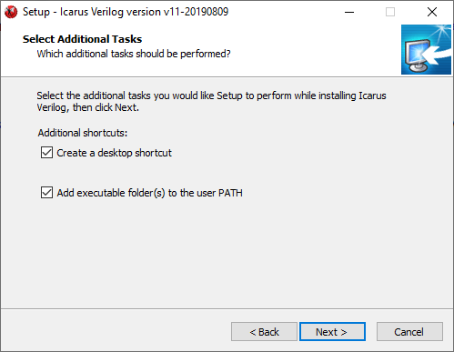
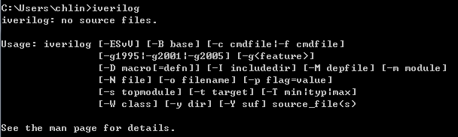
Install iverilog-10.0-x86
Download at:
http://bleyer.org/icarus/iverilog-v11-20190809-x64_setup.exe

Slide 4
Testing process
Download mux_t.v from e3
Compile:
C:\Users\helloword> iverilog -o mux_t.vvp mux_t.v
Execute file:
C:\Users\helloword> vvp mux_t.vvp
Wave visualization by GTKwave (installed in iverilog also):
C:\Users\helloword> gtkwave mux_t.vcd
p.s you can use Ctrl+C to terminate the program

Slide 5
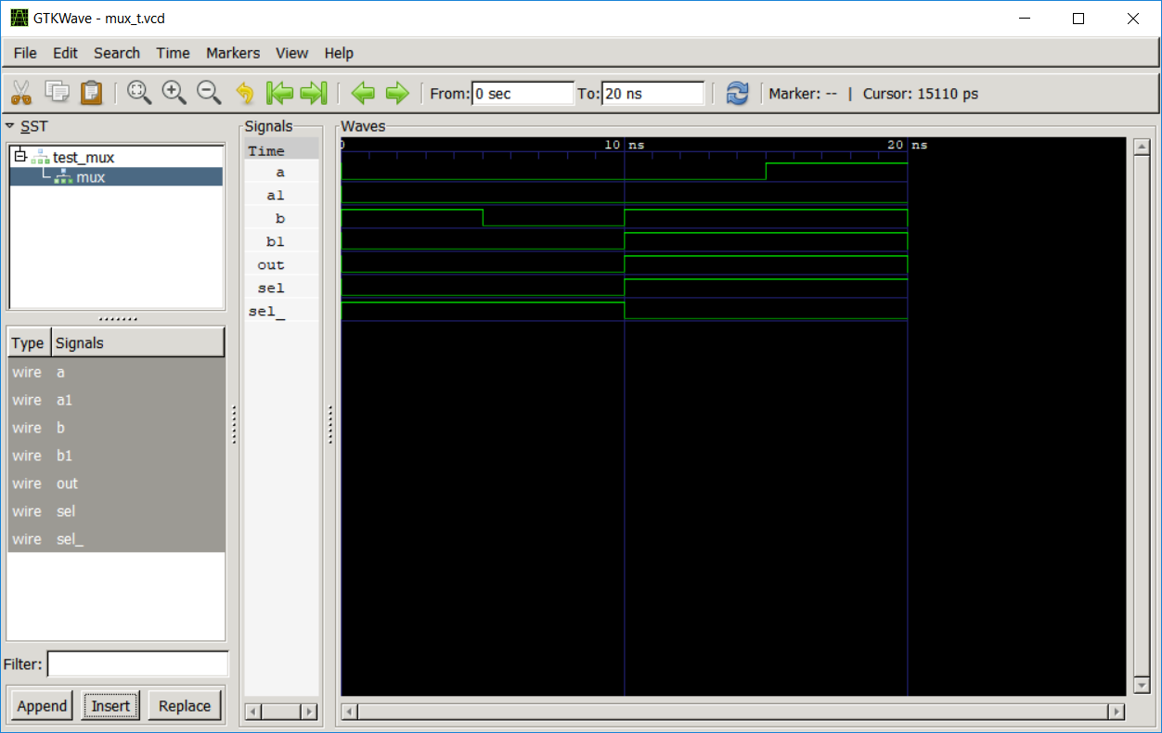
Gtkwave UI
Double-click 'test_mux', and then click 'mux'. Select all the signals and click 'Insert'.
Click 'Zoom Out' icon to show proper display.

Slide 6
Verilog MP 1
Replace the gate level description with an 'always' block for the multiplexer, and simulate your verilog file.
(You can use notepad++ to edit your Verilog code)
Upload your report (including Verilog code and timing diagram) to e3.
Only PDF format is allowed.
Filename format: hw1_studentID_Name_v1.pdf .
Due date : 2020/05/15 23:59:59 .

